Slide 1

NEST Nurturing Excellence, Strengthening Talent. ABSTRACT SUBMISSION GUIDELINES

Slide 2
Problem Statement – #4
Utilizing data to predict recruitment rate (RR) in clinical trial for benchmarking

Slide 3
Approach & methodology
Overview
Methodology
Framework / tools used
In clinical trial protocol development, predicting the recruitment rate (RR) accurately is critical for benchmarking and ensuring the trial's success. Recruitment rate refers to the speed and efficiency with which patients are enrolled in a clinical trial. A well-predicted RR can significantly impact the trial's design, execution, and overall success.
Solution Approach:
1. Data Analysis: Analyze data from similar historical research, experiments, and clinical studies to gain insights.
2. Criteria Refinement: Refine patient selection criteria based on past data to ensure efficient recruitment.
3. Benchmarking: Use historical recruitment rates as benchmarks to guide current trial designs.
4. Predictive Modeling: Develop predictive models to forecast enrollment times and adjust criteria accordingly during protocol development.
Data Collection: Gather data from clinicaltrials.gov, focusing on relevant columns.
Data Preprocessing: Encode categorical variables using Label Encoder . Vectorize textual data using TFIDF Vectorizer.
Model Selection: Use XGBoost Regressor for its efficiency and robustness.
Variables selected : Phases, Sex, Age, Funder Type , Study Type, Brief Summary, Conditions, Primary Outcome Measures , Secondary Outcome Measures , Other Outcome Measures, Sponsor , Collaborators
Variables derived : Location count , Time interval
Accuracy metrics: Train the model and evaluate its performance using Mean Squared Error (MSE) , R2 Score , Mean Absolute Error(MAE).
datetime and dateutil.relativedelta : Used for handling and manipulating dates, particularly for calculating time intervals between dates.
scikit-learn: A machine learning library in Python, used for data preprocessing, model training, and evaluation.
LabelEncoder : For encoding categorical variables into numerical values.
mean_absolute_error : For evaluating model performance.
Pipeline: For constructing a pipeline that sequentially applies a list of transforms and a final estimator.
ColumnTransformer: For applying different preprocessing steps to different columns.
TfidfVectorizer: For converting text data into TFIDF vectors
NLTK (Natural Language Toolkit): Used for natural language processing tasks.
stopwords: For removing common stopwords from text data.
WordNetLemmatizer: For lemmatizing words, which helps in reducing words to their base or root form.
re (Regular Expressions): Used for text preprocessing, such as removing non-alphabetical characters from text data.
XGBoost: An efficient and scalable implementation of gradient boosting framework by Friedman. Used for training the regression model.

Slide 4
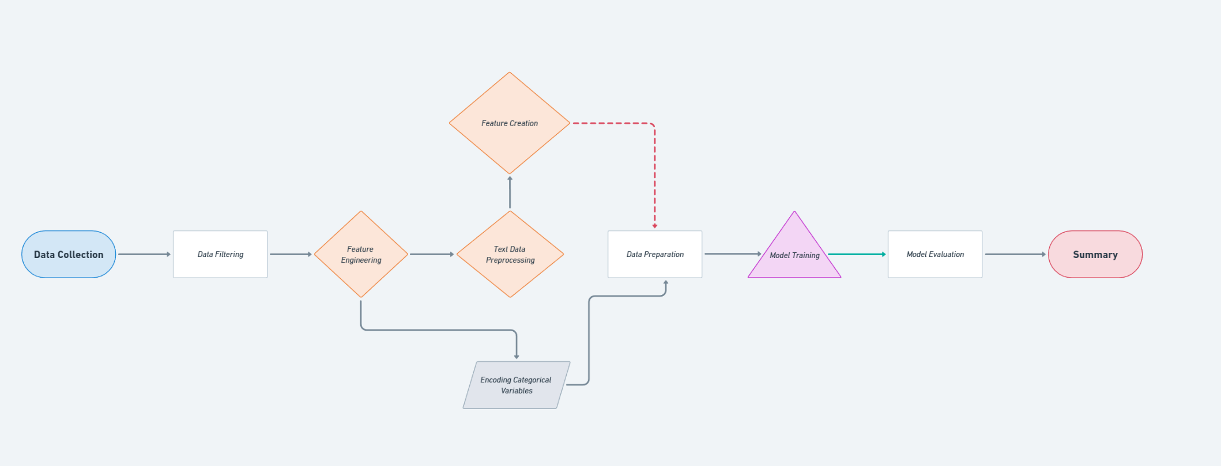
Model choice & setup
Model Selection
Model Architecture
XGBoost is highly effective in handling structured data, which makes it suitable for this dataset containing both numerical and categorical features.
The use of TFIDF vectorizer for text data allows us to convert unstructured textual information into structured numerical vectors. XGBoost can then process these vectors effectively.
XGBoost integrates well with scikit-learn’s pipeline and preprocessing tools, which allows for a streamlined workflow. Using pipelines, we can seamlessly integrate data preprocessing steps (like TFIDF vectorization and label encoding) with the model training process.
Regularization techniques in XGBoost help in preventing overfitting, which is crucial when building models that need to generalize well to unseen data. This is especially important in the clinical trial domain, where the model needs to perform well on new trials that it has not seen during training.

Slide 5
Model Training & Evaluation
Evaluation Metrics
Model Training Process:
Data Preprocessing:
Features are prepared for the model. Text data is processed using TFIDF vectorization to convert textual features into numerical vectors. Categorical features are encoded using Label Encoding to convert them into numerical representations.
Model Selection:
XGBoost Regressor is chosen for its ability to handle both structured and unstructured data efficiently, offering high performance and robust handling of missing values.
Pipeline Construction:
A pipeline is created to streamline the workflow, including text vectorization (via TFIDF) and model training (via XGBoost).
Model Training:
XGBoost learns the patterns and relationships between the features and the target variable (recruitment rate).
Model Evaluation:
After training, predictions are made on both the training sets, and performance is evaluated using Mean Absolute Error (MAE) to assess the model's prediction accuracy.
MAE is 4.11
RMSE is 7.03
R2 score is 0.95

Slide 6
Challenges & Next Steps
Limitations
Next Steps
When developing and deploying an XGBoost model for predicting recruitment rates in clinical trials, it's essential to consider potential caveats, limitations, and biases that might impact the model's performance and generalizability.
Model Complexity and Interpretability
Complexity: XGBoost is a powerful but complex model, which might overfit to the training data if not properly regularized.
Interpretability: Tree-based models like XGBoost are less interpretable compared to simpler models (e.g., linear regression), making it challenging to understand how specific features contribute to the predictions.
Mitigation Strategies
Cross-Validation: Use cross-validation to ensure the model generalizes well across different subsets of data.
Feature Importance Analysis: Regularly review feature importances to ensure the model is using relevant features meaningfully.
Bias Detection and Mitigation: Regularly check for biases in data and predictions, and consider techniques to mitigate these biases.
Model Monitoring: Continuously monitor model performance and update the model as new data becomes available or as the clinical trial landscape evolves.
By being aware of these limitations and actively working to mitigate them, the robustness and reliability of the recruitment rate prediction model for clinical trials can be significantly improved.
If more time were available or for further research, several potential improvements and next steps could enhance the model and its applicability
Feature Engineering
Advanced Text Features: Use more advanced NLP techniques, such as word embeddings (e.g., Word2Vec, GloVe) or transformer-based models (e.g., BERT), to capture richer semantic information from textual data.
Model Improvement
Experiment with Different Models: Test and compare the performance of different machine learning models, such as Random Forests, Gradient Boosting Machines, or neural networks, to find the best-performing model.
Model Validation and Testing
Cross-Validation: Use k-fold cross-validation to ensure that the model generalizes well across different subsets of the data and to avoid overfitting.
External Validation: Validate the model on external datasets or in real-world clinical trial settings to assess its performance and generalizability.
Deployment and Monitoring
Model Deployment: Develop a robust deployment pipeline to integrate the model into clinical trial design processes. Ensure that the model is easily accessible and usable by stakeholders.
By implementing these improvements and conducting further research, the model's accuracy, reliability, and usefulness in predicting recruitment rates for clinical trials can be significantly enhanced.

